Slide 1
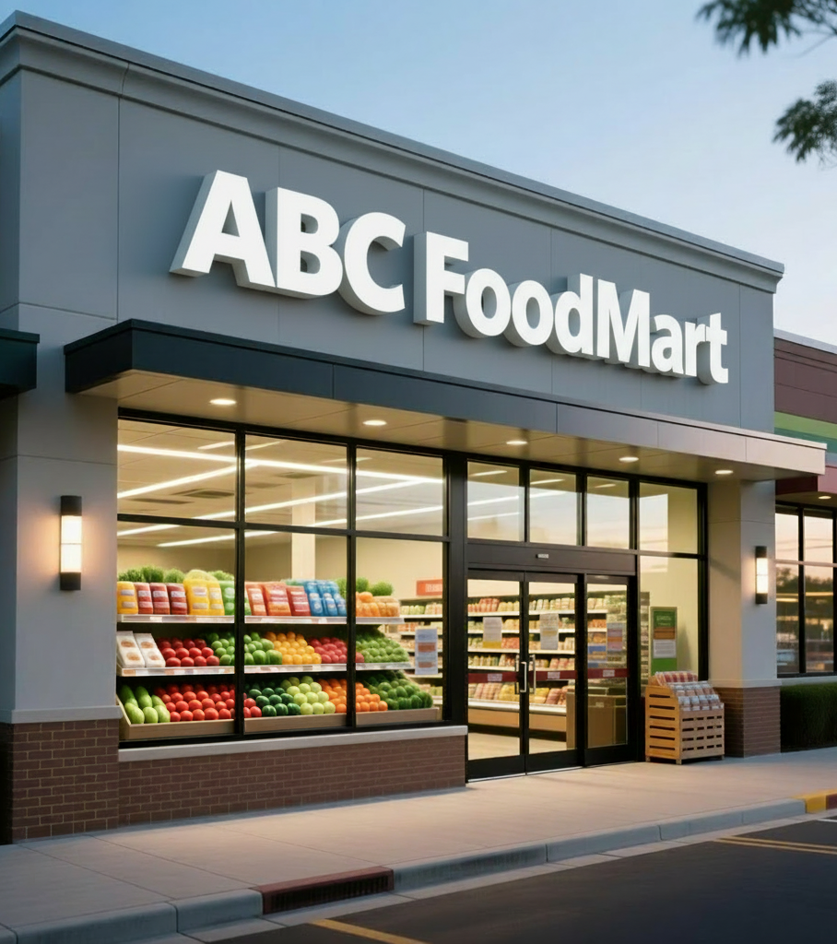
Columbia University
Driving Scalable Growth: Database Solutions for ABC Foodmart
Adeel Arif, Depali Kulkarni, Suchakrey Nitisanon, Kristen Campbell, Sana Khan, Malaikah Khan
Notes:
Adeel

Slide 2
The Client & Challenge
ABC Foodmart Today
The Problem
A grocery chain operating two locations in Queens, NY, preparing to expand into Brooklyn with three additional stores.
Operational Inefficiencies:
Error-prone bulk updates
Weak auditability and tracking
Current State: Relying on large spreadsheets for inventory, staffing, and vendor management across locations.
No cross-location coordination
Limited analytical capabilities
Multi-borough expansion requires centralized data infrastructure
Notes:
Adeel

Slide 3



Our Solution: A Centralized Relational Database
Six Interconnected Tables
Operational Efficiency
Customer Loyalty System
Eliminate spreadsheet errors, streamline inventory management, and coordinate across all locations seamlessly.
Stores, customers, products, aisles, transactions, and transaction items—all normalized to 3NF standards.
Track purchasing behavior, reward points, and transaction history to build lasting customer relationships.
This infrastructure supports ABC Foodmart's expansion while creating a foundation for data-driven decision making and customer engagement.
Notes:
Adeel

Slide 4

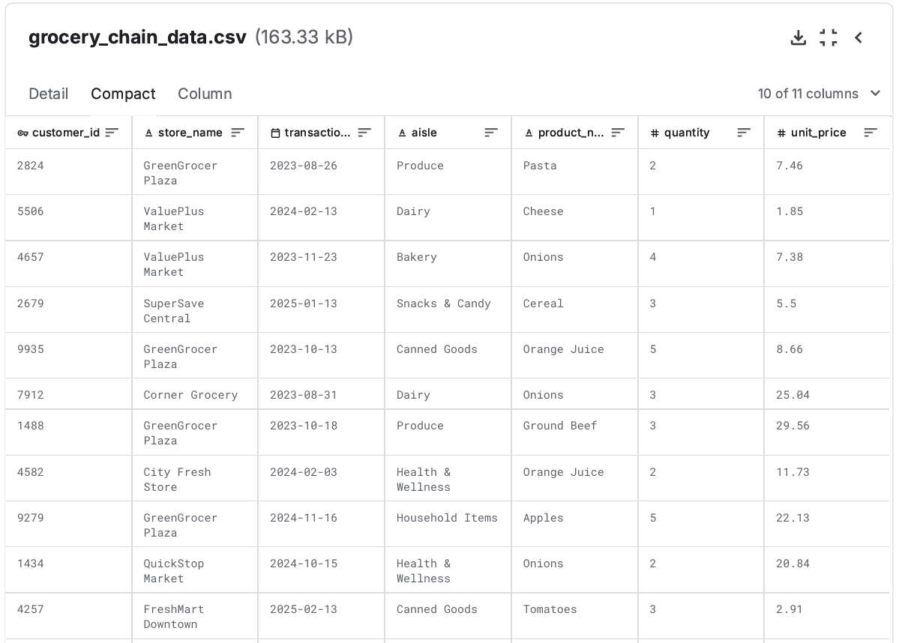
Sample Data Overview
The dataset contains 1,980 rows across 11 columns, sourced from Kaggle's grocery store sales records. Key fields include customer_id, store_name, product details, quantity, transaction_date, and pricing information.
Data Source
Kaggle Grocery Store Sales Dataset
Structured to support multi-store operations and analytical queries
This data naturally maps to normalized tables supporting ABC Foodmart's expansion needs while enabling customer behavior analysis and business metrics tracking.
Notes:
Depali

Slide 5
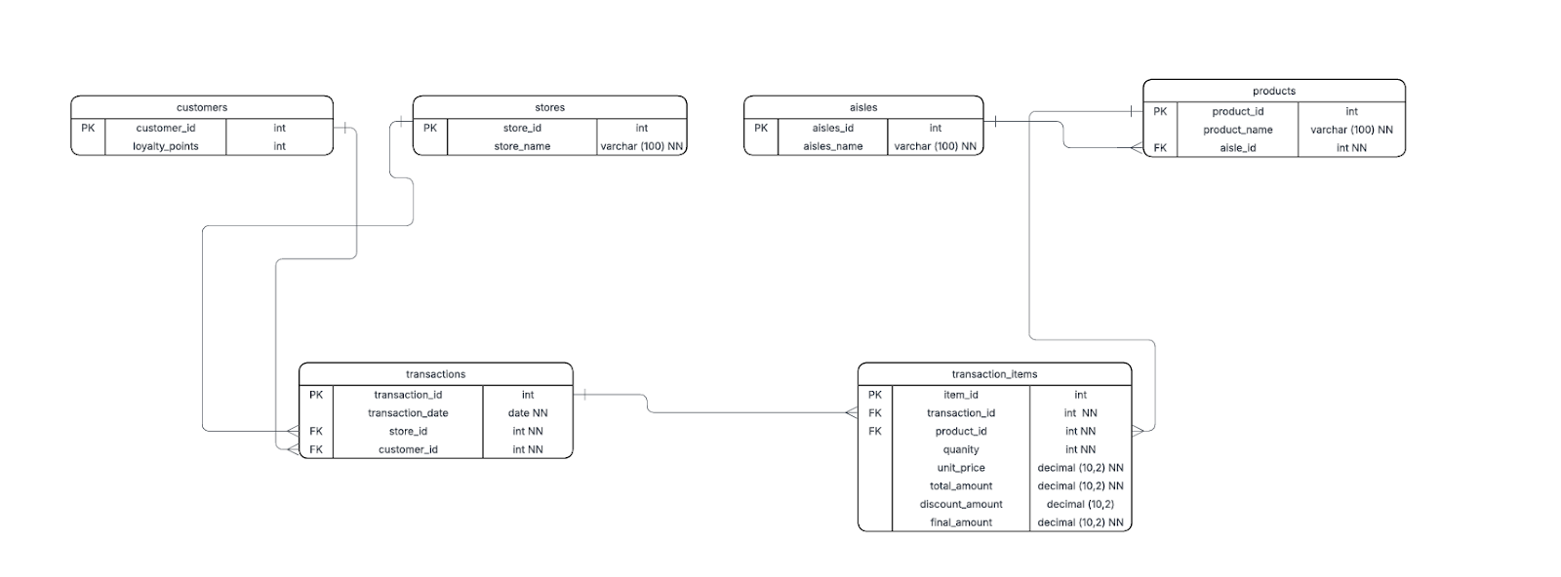
Database Schema Design
Design Principles
Entity Relationship Diagram showing table connections and foreign key relationships
Our schema follows Third Normal Form (3NF) to minimize redundancy and ensure data integrity at scale.
01
Entity Identification
Customers, stores, products, aisles, transactions, transaction items
02
Relationship Mapping
One-to-many relationships between core entities via foreign keys
03
Extensibility
Room to add staffing, vendor, and supply chain data without breaking existing structure
Notes:
Malaikah

Slide 6

The ETL Pipeline
1
Extract
Load raw Kaggle dataset into Pandas DataFrame for quality assessment
2
Transform
Correct product-to-aisle mappings, normalize data into six tables, preserve original customer IDs
3
Load
Use SQLAlchemy to insert data into PostgreSQL following foreign key dependency order
Critical Fix: Manual correction of incorrect product-aisle assignments (e.g., pasta was incorrectly categorized under produce) ensured data integrity before database loading.
Notes:
Malaikah

Slide 7
Customer Needs: What & Why
For Analysts
For Executives
Sales Performance Analysis
Real-Time Performance Monitoring
Understand which stores, products, and aisles drive revenue
Track KPIs across all locations without technical expertise
Customer Behavior Insights
Strategic Decision Support
Track purchasing patterns, repeat visits, and loyalty metrics
Data-driven insights for staffing, inventory, and expansion planning
Discount Effectiveness
Operational Efficiency
Measure promotion usage on sales volume
Identify low-performing areas and optimize resource allocation
Time-Based Trends
Accessible Analytics
Identify daily, weekly, and seasonal sales patterns for inventory planning
Visual dashboards replace complex SQL queries
Notes:
Kristen

Slide 8
Analytical Tools: The How
1
2
3
PostgreSQL + pgAdmin4
Metabase Dashboards
Python ETL Scripts
For Executives: Interactive visualizations with no SQL knowledge required
For Data Engineers: Automated data transformation and loading using Pandas and SQLAlchemy
For Analysts: Direct database access with 16 pre-built SQL scripts answering key business questions
Real-time sales monitoring
Data validation and cleaning
Aisle traffic visualization
Dependency-aware loading
Store revenue analysis
Store comparison metrics
Error handling and logging
Product revenue rankings
Automated email reports
Customer spending patterns
Discount impact assessment
Notes:
Kristen

Slide 9
Analytical Procedures: Business Questions Answered Through SQL
Store Performance & Revenue Optimization
Product & Aisle Sales Intelligence
Customer Behavior & Loyalty Insights
Understand how each store performs financially and operationally using key metrics such as:
Total revenue and revenue after discounts
Average order value (AOV) and transaction volume
Store-level discount usage and its impact on earnings
Understand what drives sales performance across product lines and categories using insights such as:
Top-revenue products and top-selling SKUs Aisle-level revenue and units sold Daily sales trends for inventory and demand planning
Understand customer value and engagement patterns using insights such as:
Highest-spending and highest-value customers Repeat visit frequency across locations Lifetime spend patterns for loyalty and retention
Notes:
Sana

Slide 10
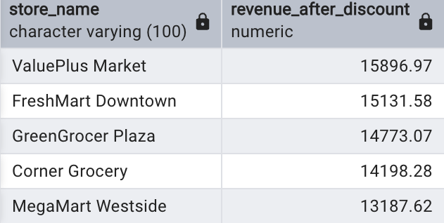
SQL Insight Deep Dive: Post-Discount Revenue Analysis
Query Purpose Calculate each store’s total revenue after subtracting all discounts.
Key Fields Used
Store-Level Fields
store_id, store_name
Transaction Fields
final_amount, discount_amount
Logic Summary Revenue After Discount = SUM(final_amount - discount_amount)
What the Business Can Learn
Identify the true top-performing stores after removing discount inflation.
Understand whether current discount strategies are boosting sales or silently eroding margins.
Impact on Decision-Making
Leadership can redesign or reduce discount programs that aren’t generating real revenue uplift.
High-performing stores (post adjustment) become models for operational best practices and resource allocation.
Notes:
Sana

Slide 11
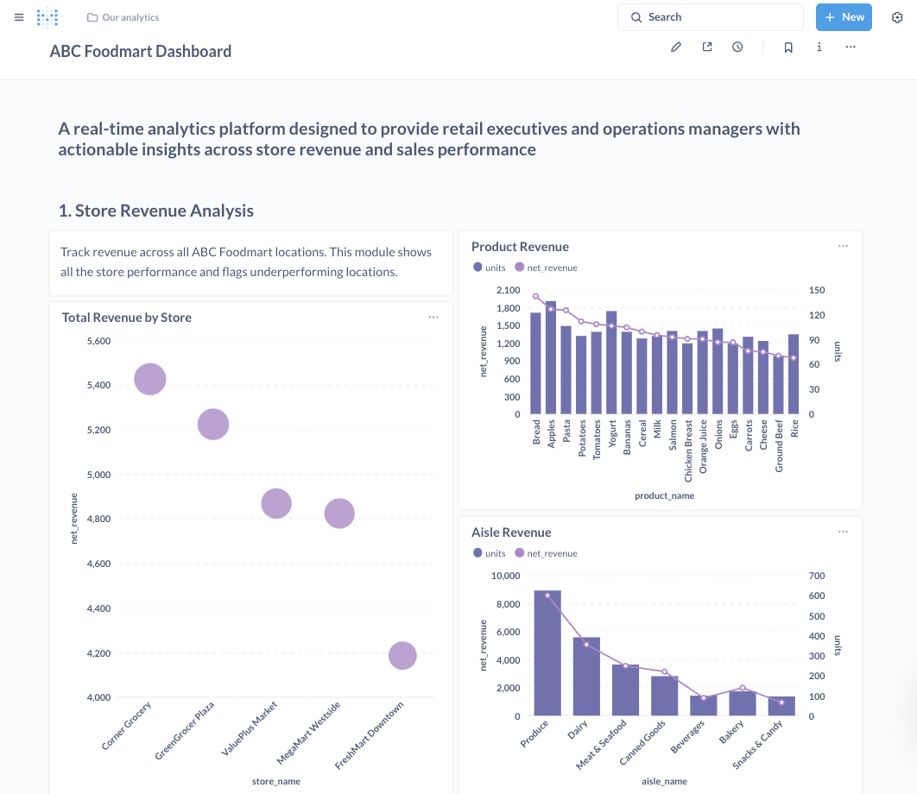
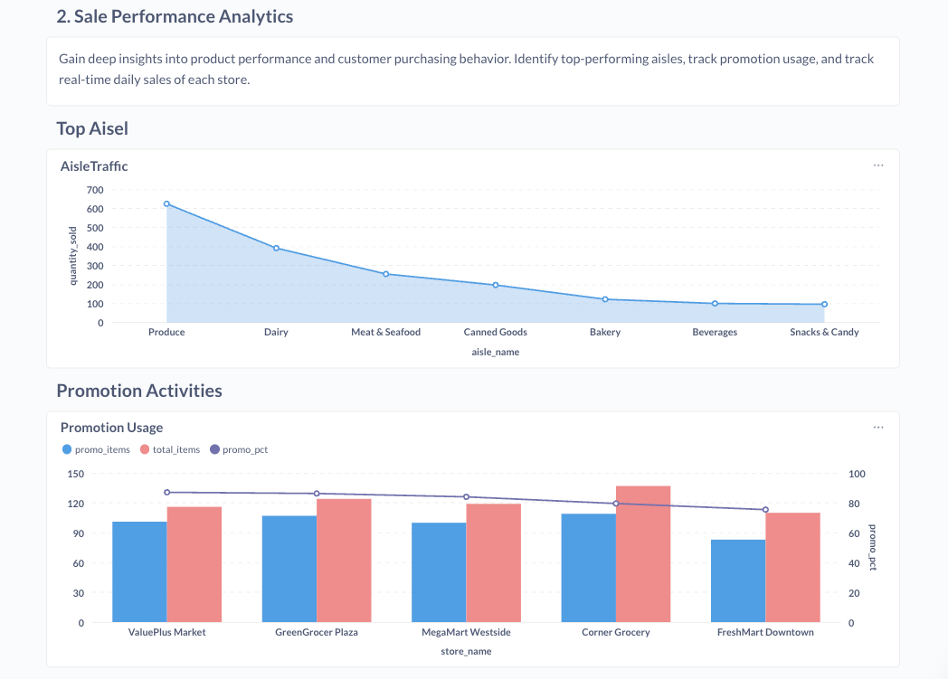
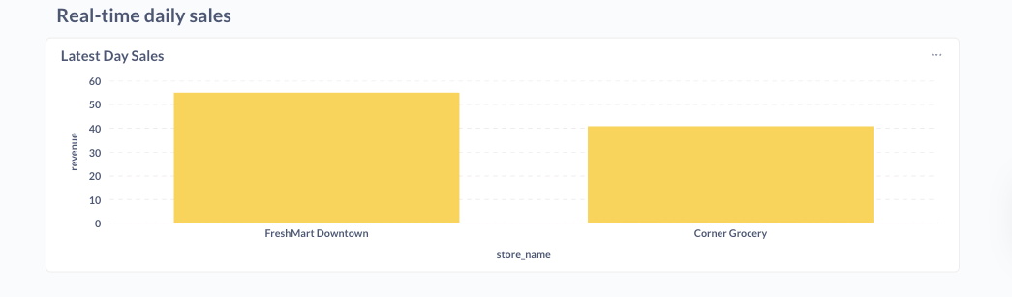
Dashboard Insights in Action
Daily Revenue Tracking
Aisle Traffic Analysis
Promotion Effectiveness
Monitor store performance in real-time with customizable date rage, location, product, and aisle breakdowns
Identify high and low-traffic areas to optimize product placement and promotional strategies
Measure discount usage by store with customized filters such as product and aisle to refine pricing strategies
Notes:
Suchakrey Nitisanon

Slide 12
Dashboard Demo
Notes:
Suchakrey Nitisanon

Slide 13
Impact & Next Steps
What We Delivered
Business Impact
Replaced error-prone spreadsheets with a centralized PostgreSQL database following 3NF standards
Scalability: Infrastructure ready to support Brooklyn
expansion and beyond
Built a Python ETL pipeline with data validation, transformation, and dependency-aware loading
Data Integrity: Elimination of spreadsheet errors and
improved auditability
Created 16 SQL analytical procedures for deep-dive analysis of sales, customers, and products
Faster Insights: Real-time analytics enable agile
decision-making
Designed executive dashboards in Metabase for real-time monitoring without technical skills
Customer Loyalty: Transaction tracking powers rewards
programs
Notes:
Adeel

